Slide 1




Module Name - Abstraction & Encapsulation
Class - Day 1
Topic Name- Classes & Objects
EditEdit MasterMaster texttext stylesstyles

Slide 2
Today’s Agenda
Introduction to OOPs
Advantages of OOPs
Introduction to Classes
Concept of Multiple Classes
Introduction to Objects
Concept of Multiple Objects
Constructor & Its Types
Use of this Keyword

Slide 3
Today’s Agenda
Use of static & final Keyword
Abstraction
Public & Private Access Modifier
Getter Methods
Setter Methods
Constructor vs Setter Methods
Private Methods & Constructors

Slide 4

Introduction to OOPs
At times in the code, there is a functionality which needs to be used repetitively and to be shared with different teams.
Consider the case of Ola app.
Suppose there are 3 different teams working for
Ola Select,
Ola Share
Ola Cafe.

Slide 5
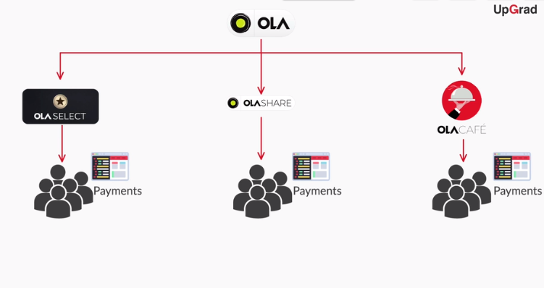
Introduction to OOPs
Now every team has to work on writing the user code for payments services. So, do you think each of them write a separate code for implementing payments? Will that be the most efficient way to build the product?

Slide 6
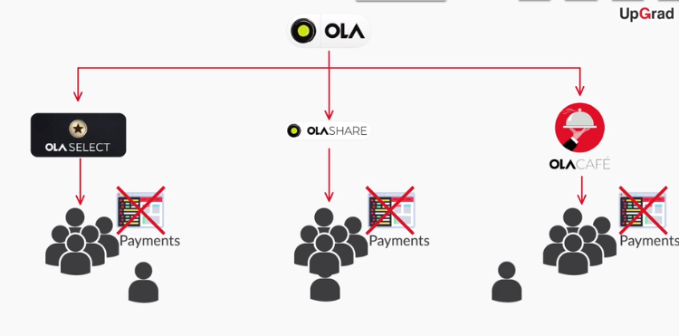
Introduction to OOPs
The ans is NO. Instead of writing the codes separately one team will write the code which can be used by other teams..

Slide 7
Introduction to OOPs
Now, it will be tedious to write separate codes for payment functionality in these three sub parts of the app.
It will be easy if the code for payment functionality is written once and then used by different teams for their sub parts.

Slide 8

Introduction to OOPs
Different projects are broken into small
entities or modules where one particular
team works on one module.
These independent modules can be used
by other teams as well.
This is where Object Oriented Programming
comes into play.

Slide 9
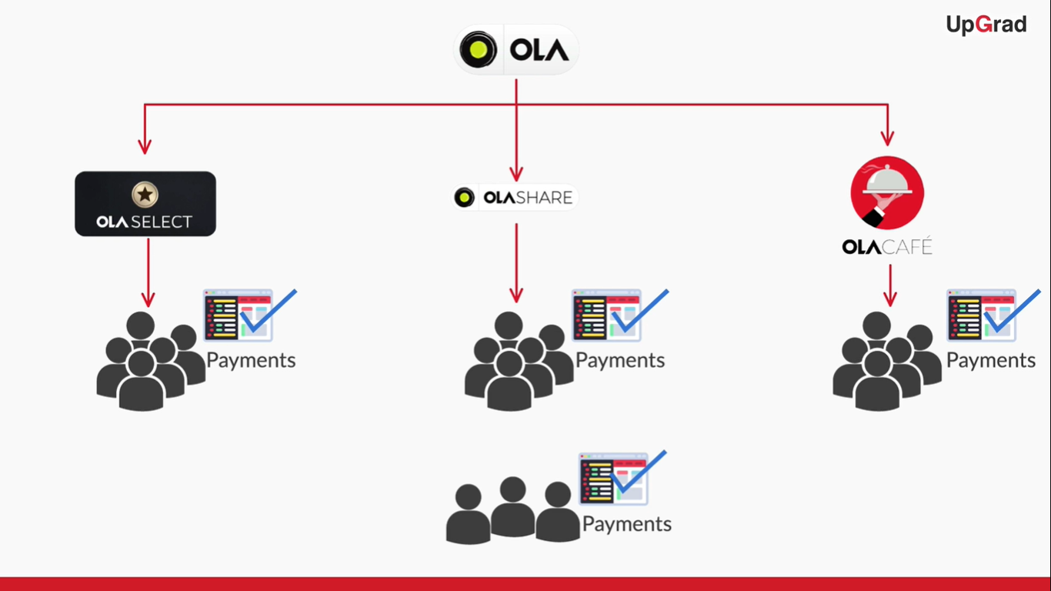
Introduction to OOPs

Slide 10
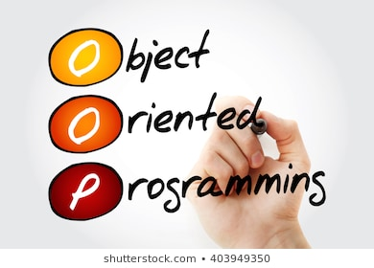
Introduction to OOPs
What is OOPs?
OOPs or Object Oriented Programming gives you a particular methodology for implementing large and
complex programming projects in a very
simple way.
It uses structure of classes and objects.

Slide 11

Introduction to OOPs
Four Principles of Object Oriented Programming
Abstraction
Encapsulation
Inheritance
Polymorphism

Slide 12

Introduction to OOPs
There are some programming languages which do not follow the concepts of OOPs and are known as Procedural programming language.
However, these general purpose
programming languages like Java,
C++, C#, Python etc are OOPs based
programming languages.

Slide 13

Advantages of OOPs
Benefits of OOPs
Building a new project becomes more
organised and efficient.
For example if the team is implementing a
Payments structure for an online product
It would be more efficient to implement it
in independent module.

Slide 14
Advantages of OOPs
Real world scenarios can be implemented naturally.
- For example in the payments module there can be different modes of payment like credit card, debit card, digital wallets and digital banking. So, the team implementing these payment options in the module, each payment mode has to be implemented by different engineers.

Slide 15
Advantages of OOPs
Modification and update of program becomes easier.
For example if you want to add a new mode of payment then you just have to add a new sub module only once in the payment module and you don’t need to do it separately for every different service. Also suppose that the debit card payments are not working properly. So, we know which sub module we have to look at instead of looking at the entire code.

Slide 16

Introduction to Class
What is a class?
A class is a blueprint of an application where you:
Implement methods to perform certain actions/functionalities
Declare variables that describe the properties of the application

Slide 17
Introduction to Class
The whole idea behind classes is to have independent modules in the program, each class representing one particular entity.
That entity can have various
data members, variables, and
methods linked to it.
class1{ .... }
class2{ .... }
class3{ .... }

Slide 18
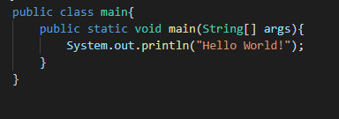
Introduction to Class
And as a good practice, the public static void main method is kept in a separate class named Main.

Slide 19

Introduction to Class
You can have a different name for the
class that contains the main method.
However, the name of the Java file has
to be the same as the name of that
particular class.
Whenever you need to assign values to
the variables of a particular class, or
call the methods of that class, you can
do it in the main method.

Slide 20
Introduction to Class
Since variables/methods are declared in a different class, and accessed/called in a different class, you need to use the dot operator to do this.
Using . operator
class1{ .... }
class2{ .... }

Slide 21
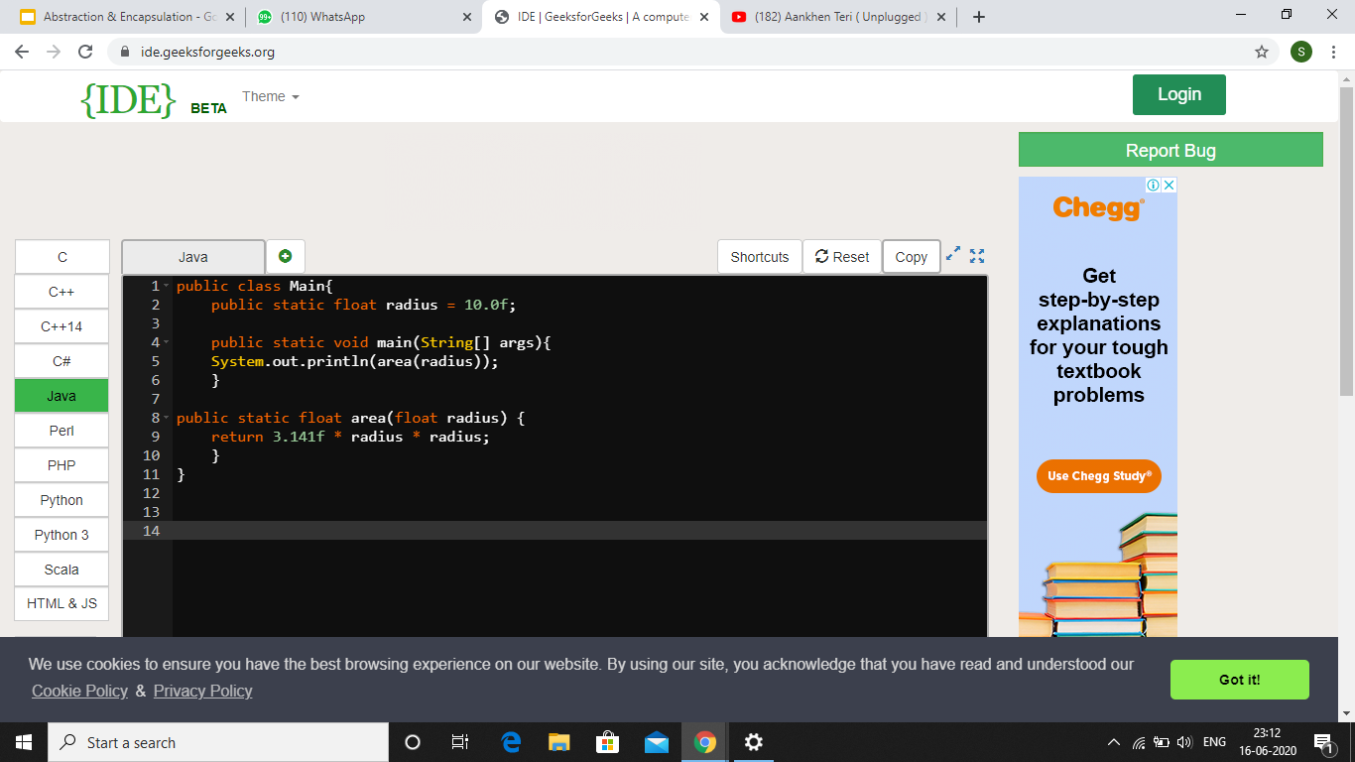
Class: Example
Class: Example

Slide 22
Class: Example
There are two methods in the main class: main method & area method.
main method
area method

Slide 23

Class: Example
Other than that, a float variable called radius
is declared in this class whose value is 10.0f.
radius variable

Slide 24
Class: Example
Area method is of type float and also takes a
single argument which is also a float value.

Slide 25
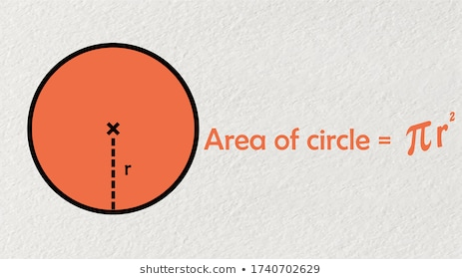
Class: Example
The argument is basically value of radius and the area method returns the area of circle when called.
It is returning us 3.14*R*R which is basically the area of the circle where R= radius.

Slide 26
Class: Example
Area method is called in the main method by passing radius variable as parameter.
And the returned value is printed.

Slide 27
Notions of Classes
Notions of Classes
One can have multiple classes in the same program.
Only one of the class can be public in a Java File.
Dot is used to call a method from another class.
The public class which we have created should be the same as the name of our file which we have saved.
Notes:
Significance of public to be taught later

Slide 28

Concept of Multiple Classes
Need for Multiple Classes
Suppose, you want to find area of another shape.
Now, you cannot have two methods with exactly
the same name and same parameters in a
single class.
If we have two methods of the same name then it will lead to the name clash and our code will throw us error.

Slide 29
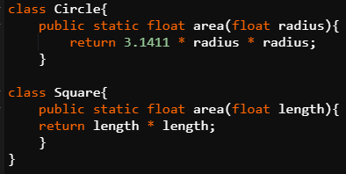
Concept of Multiple Classes
You have to put those methods in two different classes.

Slide 30
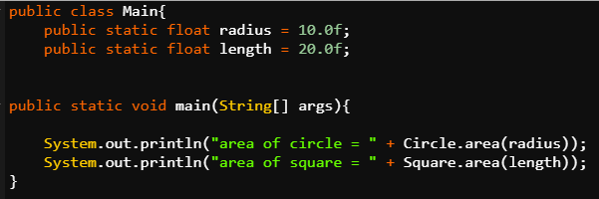
Concept of Multiple Classes
This is how these two area methods can be called.
By doing this we can avoid the name clashes and we can use the same method name to be used in several classes.

Slide 31

Introduction to Objects
Till now, you were introduced to classes and used classes as separate independent modules, i.e. used classes as a module-creation mechanism.
Time to get introduced to objects and see
more real benefits of classes.

Slide 32
Introduction to Objects
What are Objects?
If we consider the real-world, we can find many objects around us, cars, dogs, humans, etc. All these objects have a state and a behavior. If we consider a dog, then its state is - name, breed, color, and the behavior is - barking, wagging the tail, running.
Software objects also have a state and a behavior. A software object's state is stored in fields and behavior is shown via methods.

Slide 33

Introduction to Objects
Methods from different classes are called
using object only. The approach which we
used earlier to call the methods is not a
good practice and some changes are
required in that code.

Slide 34
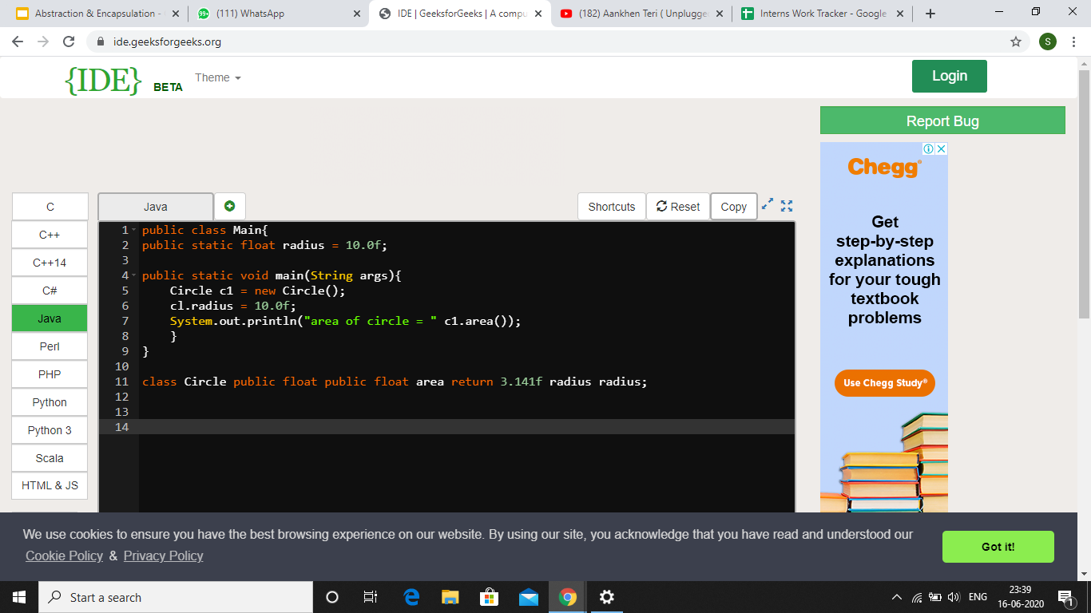
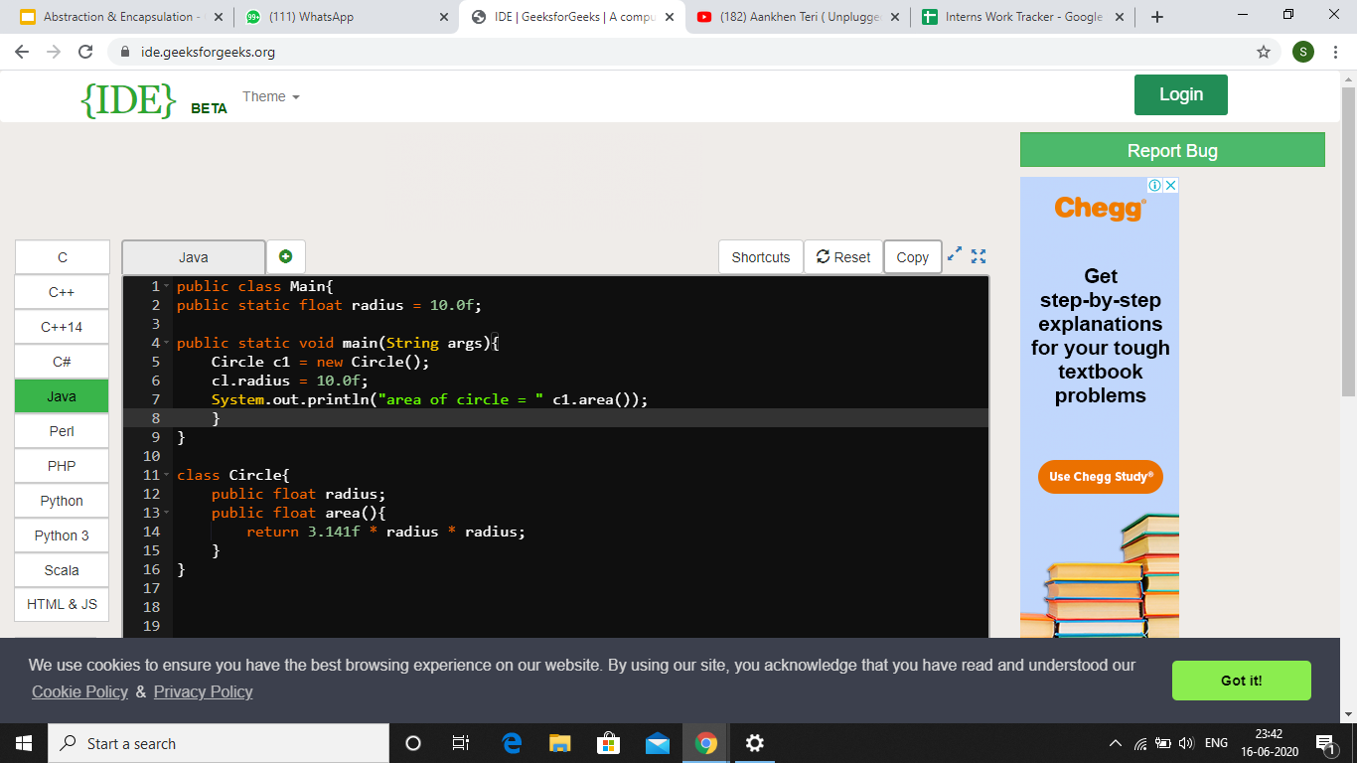
Classes & Objects

Slide 35

Classes & Objects
Changes to be made to create objects from classes: Area Example Updated
Declare the radius attribute in the
Circle class.

Slide 36
Classes & Objects
Remove the static keyword from attributes and methods.
No static keyword written before radius attribute and area method

Slide 37
Classes & Objects
Delete the parameter from the declaration of area method. This means that the radius inside the body of this area method now refers to the radius attribute inside circle class and not the radius which was earlier passed as parameter.
No parameter inside area method.

Slide 38
Classes & Objects
Create an instance(object) of the Circle class inside the main method.
Circle c1 = new Circle() // c1 object of class circle
Basically, Circle can be seen as a type and c1 as its variable.

Slide 39
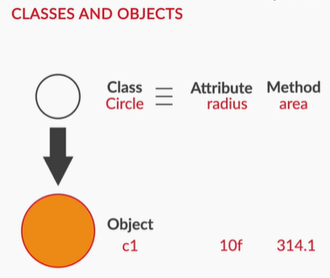
Classes & Objects
Call area method using c1.area().
Assign value to radius attribute of
circle class using c1.
c1.radius = 10f;
So, basically what object does is that
allows one to access the attributes and methods of a class outside that class.

Slide 40
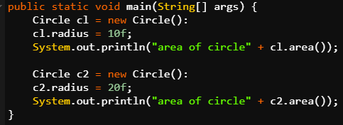
Concept of Multiple Objects
Multiple objects can be created for the same class.
Each object can set their own values for the attributes and call the method with those values into consideration.

Slide 41
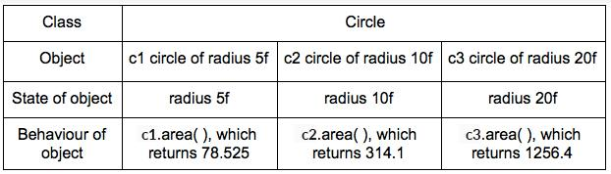
Concept of Multiple Objects
What is state and behaviour of an object?
The state of an object refers to the specific values of the variables of the class the object belongs to.
The behaviour of an object refers to the action performed by the object when called by a particular method from the class.

Slide 42

Concept of Multiple Objects
Relation between a Class and its Object
Let’s take another example of a house class to understand this better. Suppose that an architect designs a blueprint for a house.
This same blueprint can then be used to build multiple houses.
A single blueprint is useful to build several houses that have the same architecture.

Slide 43
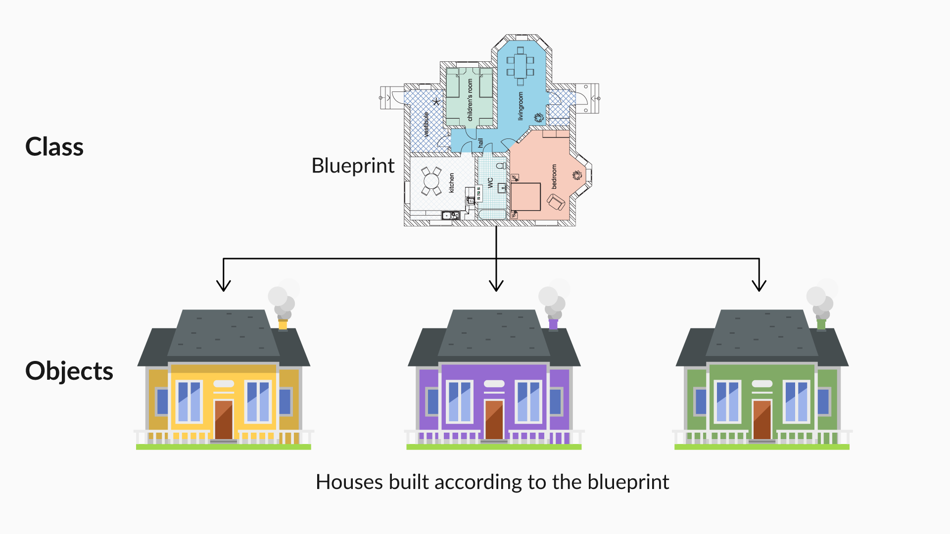
Concept of Multiple Objects
The concept of classes and objects is similar to this. Here, the house blueprint
acts as a class
and a particular
house represents
the object.

Slide 44

Multiple Objects in a Class: Application
You have already been introduced to the concept of multiple objects of a class.
It’s time to see how this concept is practically used to solve various purposes.

Slide 45

Multiple Objects in a Class: Application
Let us take a new example of a class named
Student in a software system like a university’s
information management system.
Student Class:
Variables: Name, Roll number, CGPA
Methods: Edit profile, Register for a
new course, Submit assignment, Check
result

Slide 46

Multiple Objects in a Class: Application
For the Student class, your objects would be different students — s1, s2, s3 — with names such as
Prateek, Ankit, and Ajay.
There can be thousands of objects, where
each object has all the characteristics of the
Student class.

Slide 47

Multiple Objects in a Class: Application
Instances: An object of a class is also referred to as an instance. The word “object” or “instance” can be interchangeably used.
For example, s1, s2, s3, etc. are all
instances or objects of the Student class.

Slide 48
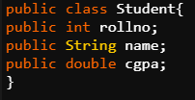
Multiple Objects in a Class: Application
Instance variables: Instance variables are variables from the class, which become the characteristics (or states) of the objects/instances. Every object has its own copies of instance variables.
For example, roll number, name, CGPA are all
instance variables of the Student class which
will Become characteristics of student object like student objects S1 with rollno-1, cgpa-8 and name-Varsha and S2 with rollno-2, cgpa-9 and name-Pratik.

Slide 49
Multiple Objects in a Class: Application
An information system can have more than one class.
As we have seen the student class here there can be other classes also like professors, faculty etc.
A class can have multiple attributes.
We have rollno, cgpa and name as attributes of student class.

Slide 50
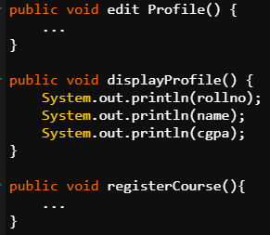
Multiple Objects in a Class: Application
A class can have multiple methods
Class can have different functions inside it as in student class we have displayProfile and registerCourse as two methods.

Slide 51
Multiple Objects in a Class: Application
.
Multiple objects can be created for a single class
The student class can be used to create various student objects like s1 with rollno-1, cgpa-8 and name-Varsha and S2 with rollno-2, cgpa-9 and name-Pratik.

Slide 52
Multiple Objects in a Class: Application
State and behaviour of instances:
Specific values assigned to these
variables for a given instance is
represented as the state of that
object/instance, calling the methods
would be represented as the behaviour
of that instance.

Slide 53
Multiple Objects in a Class: Application
Modelling Real-Life Scenarios Using Classes and Objects
University Information Management System:
Classes
a. Student
b. Professor
c. Course
Methods
a. OfferCourse() in Professor class
b. RegisterCourse() in Student class
Objects
a. Prof. Sujit, Prof Tricha for Professor class
b. Compilers, Internet of things for Course class

Slide 54

Introduction to Constructor
Now, you know how to create and use objects in your code. So, it’s time to get introduced to constructors, which will help you create classes in a more efficient way.

Slide 55

Introduction to Constructor
What is a Constructor?
Constructor is a special type of method used
to initialize an object of a class and define
values of the instance variables of the object.
You can call a Java constructor while creating
a new object. It constructs the values for the instance variables, i.e. provides data for the object. This is why it is known as a constructor.

Slide 56
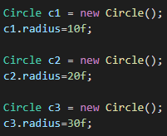
Introduction to Constructor
We see that everytime we are creating an object for
a class we have to do this laboursome activity of
initializing its variables to a particular value (like
radius here in the above example for Circle class).
Here we are declaring three objects for Circle class and we have to initialize
its radius everytime.

Slide 57
Introduction to Constructor
The fact that we have to do this as 2 seperate instructions in our code to make our code particularly error prone but there can be an instance where you can forget to initialize the radius attribute of any object to a particular value. This is not desirable to us which makes this practice inefficient.
So we need to have some mechanism to ensure that any object creation out of a class is done using a safe and efficient mechanism.

Slide 58

Introduction to Constructor
Constructor will initialize the value of Circle variable radius as soon as object of Circle class is created.
So, there is no need to initialize the value of radius again and again when the object is created.
Constructor of class Circle

Slide 59
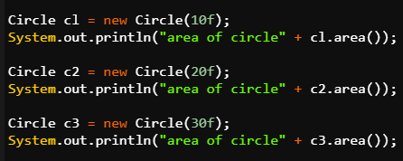
Introduction to Constructor
Rather, the values for radius variable for different objects can be passed as parameters while creating the objects.
These values act as an argument to constructor method.

Slide 60

this Keyword
this Keyword
The 'this' keyword is often used in classes to refer to instance variables.
The 'this' keyword is used to distinguish the instance variables from parameters that have the
names as the instance variable,
and makes declaring of a constructor
easier.

Slide 61
this Keyword
The 'this' keyword is used to refer to the current class instance variable. If there is ambiguity between the instance variables and parameters, this keyword resolves the problem.
For example, if there is an instance variable named name declared inside a class, it can be referred to as this.name in all the methods within that class.

Slide 62
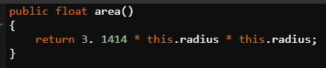
this Keyword
Even if there is no ambiguity, there is no harm in using this operator whenever you want to use the instance variables.
this.radius refers to the instance variable of class Circle.

Slide 63

Types of Constructors
Types of Constructors
Constructors are of two types:
Parameterized constructor
Default constructor

Slide 64
Types of Constructors
Parameterized Constructor
A constructor that has parameters is known as a parameterized constructor. A parameterized constructor is used to assign different values to the instance variables of distinct objects.
class name(___ , ___, .....)

Slide 65
Types of Constructors
Default Constructor
A constructor that has no parameter and does nothing apart from creating a new object is known as a default constructor.
It is a method that need not be declared if there is no parameterized constructor. The compiler will declare it itself whenever the object for that class is created.
class name( )

Slide 66
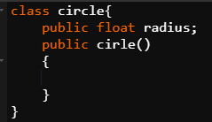
Types of Constructors
You can also declare it yourself and leave it empty in case of a declaration of other parameterized constructors.
When an object will be created with no parameters, then this default constructor will be called and the value of instance variable radius will be zero.

Slide 67

Introduction to static & final Keyword
Time to learn about two important keywords while programming in Java - static and final.
They are very helpful in making your program
more safe and memory efficient.

Slide 68

Static Keyword
Static Variable
Variables declared as static are known as static variables. Static variable is used while referring to the common property of all the objects of the class.
The static variable is allocated memory only once,
at the time of loading a class.

Slide 69

Static Keyword
For example, university name for students in the Student class for an information management system
of a university.
Static variables are useful if you need to
share the same set of information across all objects of a class, such as the University name in our example.

Slide 70

Static Keyword
Static Methods
Methods declared as static are known as
static methods. A static method belongs
to the class, rather than object of a class.

Slide 71

Static Keyword
It can be called without creating the object of the class, using ClassName.staticMethod( ) notation.
Static methods cannot access non-static
variables, or call non-static methods. But
static methods can access any static
variable and change its value.

Slide 72
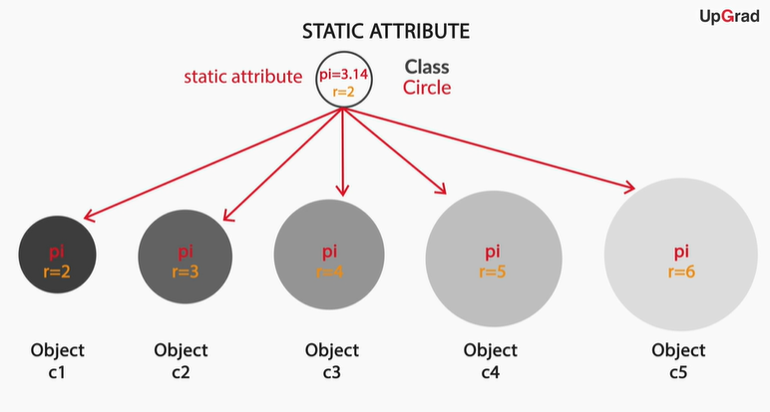
Static Keyword
Variable pi declared as a static variable as it’s value has to be same for all the objects

Slide 73

Static Keyword
Note: main method is declared as static. It will be unique for any Java File. One can have other methods also named as main but they must not be declared as public static.

Slide 74

Final Keyword
Let’s now learn about the final keyword.
The final keyword is used to restrict the user.
If any method is declared as final, you cannot
override that particular method.

Slide 75

Final Keyword
Final variables
If any variable is declared as final, you cannot
change the value of that variable. It can be
assigned any value only once, and then it
remains constant throughout the program.
Final variables are useful if you have global constants in your programs that should never be changed.

Slide 76
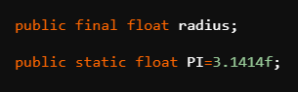
Final Keyword
This is how radius variable is declared as final. Its value could have been initiated at this step only.
Like here, it is assigned no value, so
it has the default value and if there is any attempt to change its value in any other step then the code will show an error.
Note: A variable can be declared as a static final variable also. It will be a static variable whose value can’t be changed once initialized.

Slide 77

Final Keyword
Final methods
If you declare any method as final, you cannot override that.
Notes:
Meaning of overriding to be explained later

Slide 78
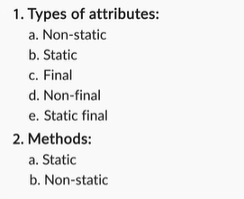
Types of Attributes & Methods
Types of Attributes & Methods

Slide 79

Abstraction: First Principle of OOPs
You have learnt various topics such as classes and objects, default and parameterized constructors, and static and final keywords.
All of these concepts fall under the umbrella
of the first principle of OOP — Abstraction.

Slide 80

Abstraction: First Principle of OOPs
What is Abstraction?
Abstraction is a principle based on hiding the
details of implementations of classes, and
access only certain features/functionalities
given to the users/other parts of the program.
This is done by writing your program using the framework of classes and objects.

Slide 81

Abstraction: First Principle of OOPs
Advantages of abstraction:
Abstraction allows you to use the functionality (behaviour) of the objects from other parts of the code
without showing the internal
implementation of that functionality
(methods).
Rights to change the implementation of a class can be given only to a certain set of users.

Slide 82

Abstraction: First Principle of OOPs
Others cannot go and arbitrarily change
anything within the class, apart from using the
behaviors defined by that class by creating
and using its objects.

Slide 83
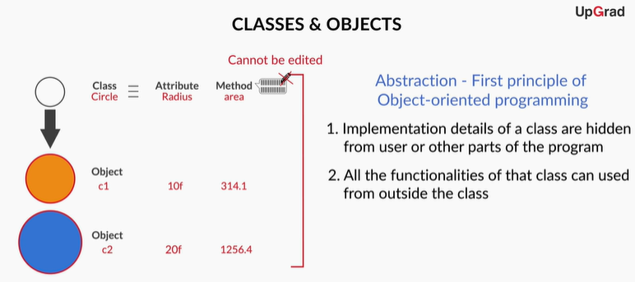
Abstraction: First Principle of OOPs

Slide 84
Abstraction: First Principle of OOPs
GOOD DESIGN PRINCIPLES FOR CLASSES & OBJECTS:
1. Identify the problem and start thinking about it using computational thinking framework
2. Start thinking about what can be modelled as classes, their methods and their objects.
3. Identify which method would belong to which particular class.

Slide 85

Introduction to Access Modifiers
You must have encountered a term named public in all our codes. What does this represent? What purpose does it solve?
Is it another keyword in Java?
Well, the answers to all these questions can be
given when you’ll have knowledge about concept
of Access Modifiers.

Slide 86
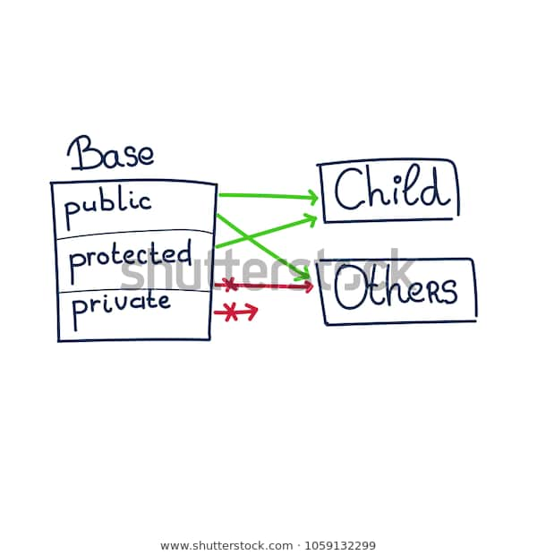
Introduction to Access Modifiers
What are Access Modifiers?
Access modifiers are used to restrict the
accessibility of methods or variables of a
class. There are four types of access
modifiers—public, private, protected, and
default—in Java.

Slide 87

Public Access Modifier
Public
When you declare a variable or a method as public in a class, it signifies that it can be
accessed throughout the class.
You can access these variables and
methods from other classes as well.

Slide 88
Public Access Modifier
When a method of a class is declared as public, it can be accessed by creating an object of its class in other classes.
If it is a static method, then you can directly access it using className.method() without creating an instance.
This creates potential issues because other classes can now access these public variables and methods and write code that depends on them.

Slide 89
Public Access Modifier
This will reduce your flexibility to change the implementation of these public variables and methods at a later point.
This is because it will affect other classes that depends on these public variables and methods.

Slide 90

Private Access Modifier
Private
When you declare a variable as private in a class, it signifies that it can be accessed throughout
the class but not outside of it.
You can’t access it from another
class.

Slide 91

Private Access Modifier
When a method is declared private, it cannot be accessed by creating an object outside the
class.
It is restricted only to the class
that contains it.
Notes:
protected and default access modifiers to be taught later.

Slide 92
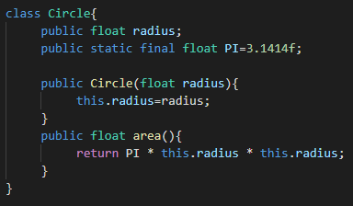
Private Access Modifier
Suppose there is any circle class which has an area method inside it taking radius as input.
Notes:
protected and default access modifiers to be taught later.

Slide 93
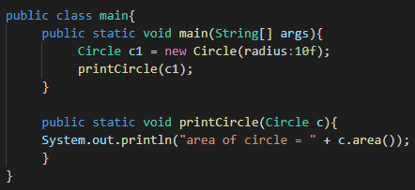
Private Access Modifier
Now we create an object for circle class in our main class and specify the value of radius in it. Main class also contains a printCircle method.
Initially area will be computed by printCircle method using this specified value of radius.
Notes:
protected and default access modifiers to be taught later.

Slide 94
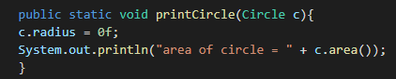
Private Access Modifier
Here the program will work smoothly and return us the correct area for our specified radius but if by mistake we specify different radius inside printCircle method then that radius will override our specified radius.
The area will be computed using this radius now which we don’t want.
Notes:
protected and default access modifiers to be taught later.

Slide 95
Private Access Modifier
This is happening because the radius attribute in our Circle class is public.
Radius is public
Notes:
protected and default access modifiers to be taught later.

Slide 96
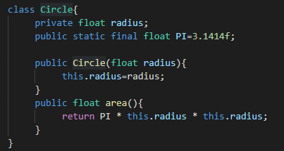
Private Access Modifier
Hence if we change public to private than nothing can override our specified radius as it can’t be changed outside Circle class. Even if we write other radius in printCircle as before, our radius will still not be changed.
Notes:
protected and default access modifiers to be taught later.

Slide 97

Getter Methods
Although, private modifier saves a variable or method implementation from getting altered but a disadvantage with the private modifier is that it does not even allow to read or print the value of the variable.
So, how to solve this problem?
This is done using getter method.

Slide 98

Getter Methods
Getter methods
Getter methods are used to access private
variables from outside the class in which
they are declared.

Slide 99

Getter Methods
class Demo {
private int var = 5; //assigning a value to the private int variable
public int getVar() {
return var;
}
}
After this code, you can access the value assigned to this variable from outside the class.

Slide 100

Getter Methods
You can do this by calling the getVar( ) method from outside the class in the following manner:
public static void main(String[] args) {
Demo d = new Demo();
d.getVar(); // calling getVar method to access its value
}

Slide 101
Getter Methods
In this example, getVar is the getter method. Now, var was a private variable whose value can’t be accessed directly in the main method. But, getVar can access var as it is in the same class.
Also, getVar is a public method. So, it can be called in the main method which is in the different class. So, eventually var was accessed in a different class indirectly.

Slide 102
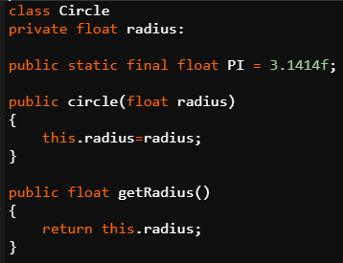
Getter Methods
Getter method can be created for any attribute whose value has to be accessed for reading or printing.
Getter Method for radius Attribute

Slide 103

Setter Methods
After getter methods, now it’s time to get introduced to another similar type of method known as the setter method.
Setter methods are used to set a new value to
private variables, or modify their values from
outside the class in which they are declared.

Slide 104
Setter Methods
class Demo {
private int var; // just declaring a private int variable
public void setVar(int var) {
this.var = var;
}
}
After this code, you can assign a new value to this variable from outside the class by calling the setVar( ) method from outside the class.

Slide 105
Setter Methods
public class ClassesAndObjects {
public static void main(String[] args) {
Demo d = new Demo();
d.setVar(5); // calling setVar method to modify its value
}
}

Slide 106

Setter Methods
The setter method uses the same approach as getter only.
The only difference is that inside its
method definition, the setter method
sets the value of attribute using this
keyword instead of just returning the
value.

Slide 107

Constructors vs Setter Methods
You know that constructors are also used for the purpose of initialising the instance variables while creating a new object.
So, what would be the major difference
between a setter method and a
constructor?

Slide 108
Constructors vs Setter Methods
Constructor vs Setter methods
Constructors are automatically called as soon as the object is being created, whereas setter methods can be called after the object is created, for example, when you want to set/modify the value of any instance variable.
Name of a constructor is always the same as the name of the class.

Slide 109
Constructors vs Setter Methods
No return type (void, int, String, etc) is mentioned in case of constructors.
Different constraints for the values of variables can be added to the setter methods.
You can also call the setter method from the constructor, if you want to place constraints on the values of the instance variables of the class while creating a new object. Next slide contains the code for it.

Slide 110
Constructors vs Setter Methods
class Demo {
private int var; // just declaring a private int variable
public Demo(int var) { // declaring parameterized setter method
setVar(var);
}

Slide 111
Constructors vs Setter Methods
Continued….
public void setVar(int var) { // declaring setter method
this.var = var;
if (this.var < 0){ // adding constraint
this.var = 0;
}
}
}

Slide 112
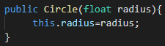
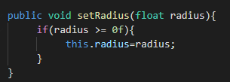
Constructors vs Setter Methods
Constructor vs Setter: Example
Constructor----->
Setter------------>
How can we modify constructor
To initialize the radius using
setter method?

Slide 113
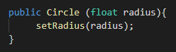
Constructors vs Setter Methods
Instead of directly assigning a value to radius using this.radius we can call setter method inside constructor as follows
By doing this we have ensured that our radius is always a non negative variable. If we don’t use setter method than during object creation someone can specify a negative radius too.

Slide 114

Private Methods & Constructors
You can also declare the methods or constructors as private.
private methods: If you declare a method of
any class as private, you can call that method
within that class only and there is no way to
call it from outside that class.
private constructors: If you make any class constructor private, you cannot create the instance of that class from outside the class.

Slide 115

Private Methods & Constructors
square method() is used by the area
method() as they are in the same
Class.
However, it can’t be used outside
its own class.
Private Method: Example

Slide 116
Applications of Private Access Modifier
Applications of Private Access Modifier
Declaring attributes as private
Getter Method
Setters Method
Declaring method as private

Slide 117
Applications of Private Access Modifier
Declaring constructor as private
Not possible to make objects of that class in this case
Can be used in specialised cases

Slide 118

Thank you!
#LifeKoKaroLift

